Slide 2
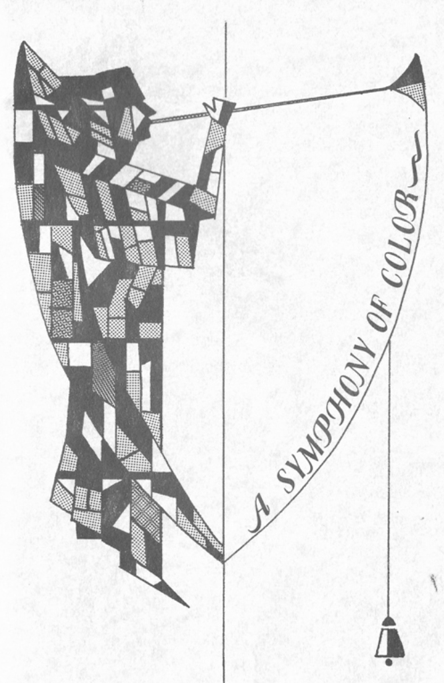
St John’s History - publications

Slide 3
St. John’s Clergy

Slide 4
St. John’s By the Sea

Slide 5
St John’s By the Sea

Slide 6
Plans for new church

Slide 7
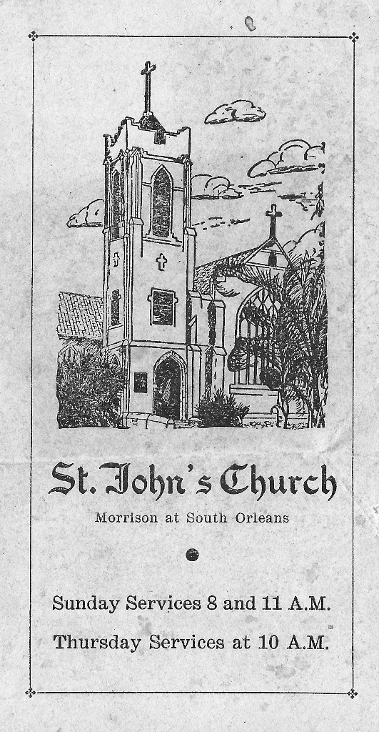
1928 Dedication of New Church Building and Informational Flyer

Slide 8
Old and New

Slide 9
Original Interior

Slide 10
Work on interior

Slide 11
New building interior

Slide 12
St John’s expansion – 1949 letter from FR Brickman

Slide 13
Photos from 1950

Slide 14
Germany 6-15-1951

Slide 15
Germany – FR Brickman

Slide 16
Carte & FR Brickman

Slide 17
Carte-June 27 1953 no ac

Slide 18
Murphey Wedding 12-01-54

Slide 19
Murphey wedding 12-01-54

Slide 20
New Church

Slide 21
Dorsey Smith

Slide 22
Mid 1960’s Easter

Slide 23
Confirmation Class: December 5, 1965

Slide 24
Biggars Choir

Slide 25
1974 Hoyt Massey

Slide 26
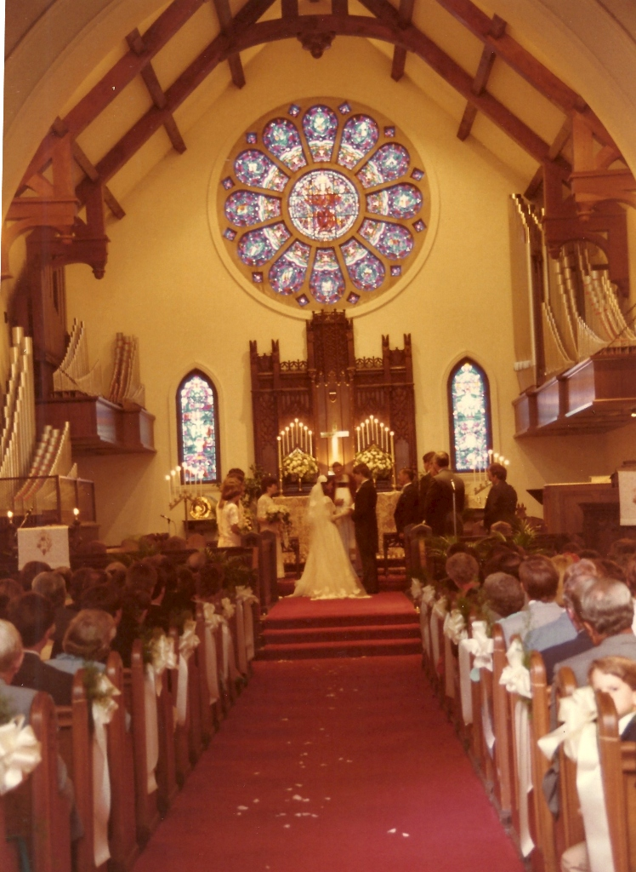
Mid 1980’s the next generation Carte (Bisbee) & Germany (Gruetzmacher)

Slide 27
St John’s Pre-Chapel Addition

Slide 28
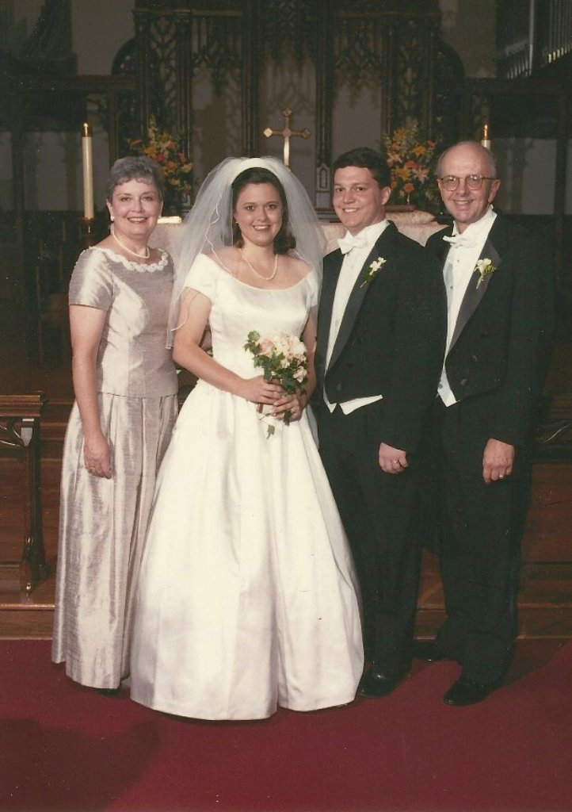
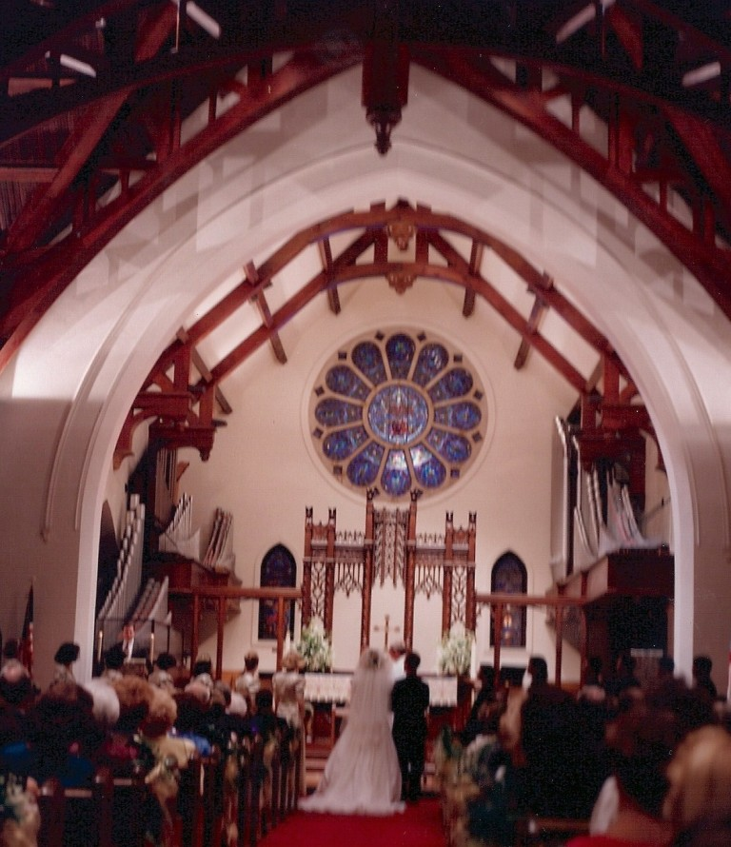
More changes to St. John’s - Hobby, Stanford & Carastro Weddings

Slide 29
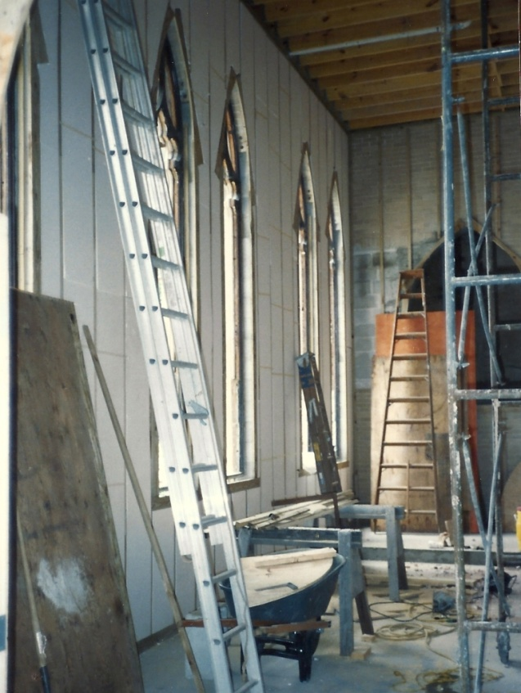
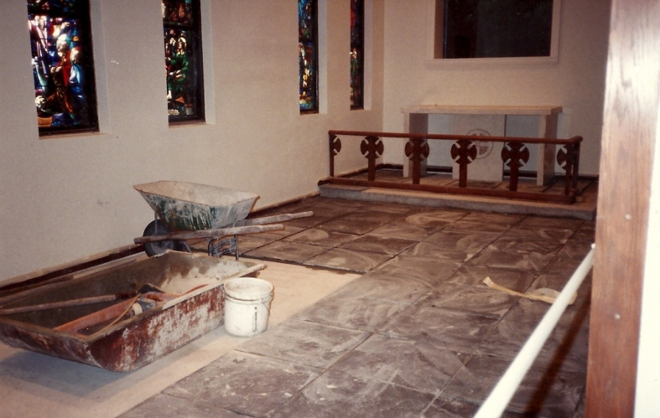
St John’s Renovation – Second Century

Slide 30
The Rev George S. Burchill: Headmaster 1954-1992

Slide 31
St John’s Parish Day School Staff: 1950’s - 1991

Slide 32
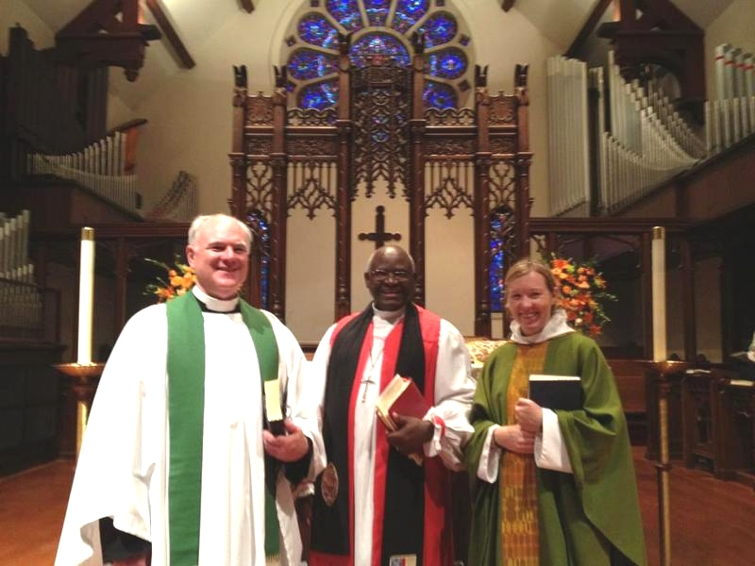
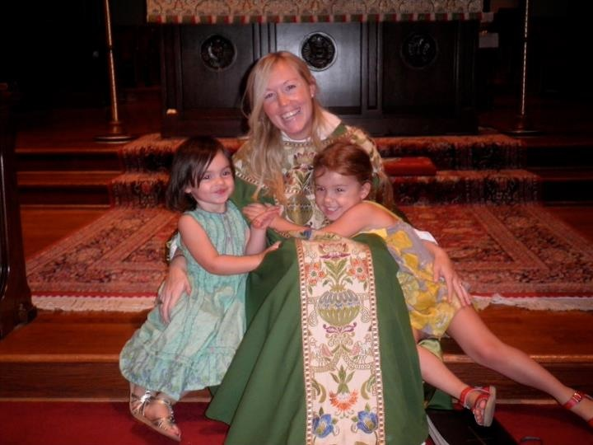
St John’s Today

Slide 33
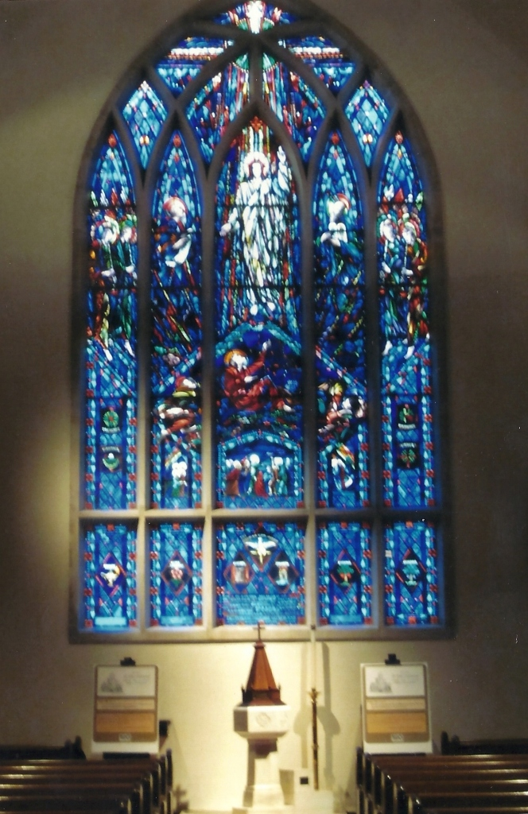
Lowry Window (family picture and current photograph)

Slide 34
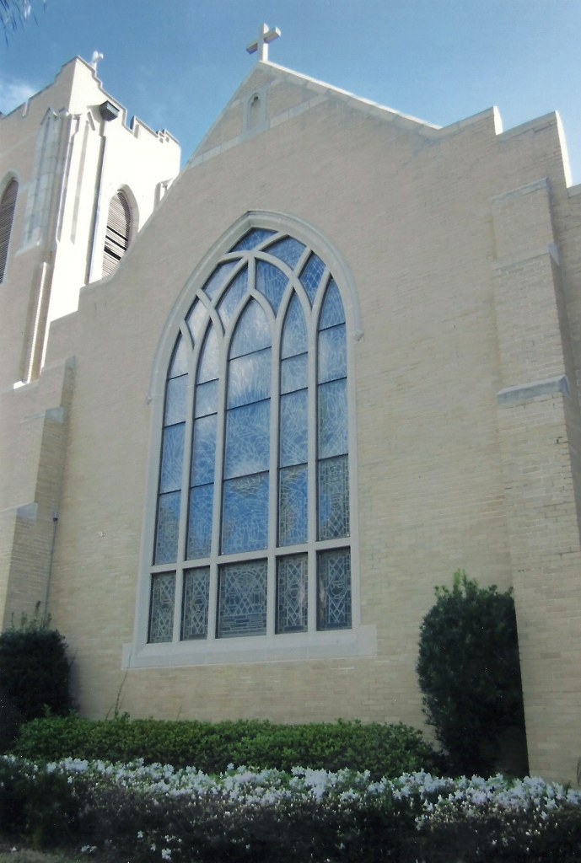
St. John’s Today - exterior

Slide 35
St John’s Today - interior

